Slide 1
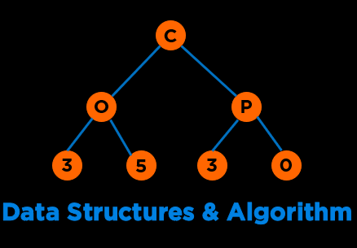
Algorithm Paradigms
Notes:
Hi everyone, welcome to the second module of the course

Slide 2
Announcements
Exam 2 will be on April 14, 3 pm - 9 pm EST.
Cumulative, 80:20 Ratio
Everything we cover till today will be a part of the Exam
Topics and Expectations guide will be up by tonight
Exam 2 reviews:
April 10th 6 pm EST: Eta Kappa Nu (unofficial)
April 12th in class
April 13th in discussions
Notes:
Discussed, touched upon, went over, covered
Emerges out of the limitations offered by our second approach

Slide 3
Categories of Data Structures
Linear Ordered
Non-linear Ordered
Not Ordered
Lists
Trees
Sets
Stacks
Graphs
Tables/Maps
Queues
Notes:
Data structures are ways to collect data. There are basic categories of data structures:

Slide 4

Categories of Algorithms
Brute Force
Divide & Conquer
Greedy
Dynamic Programming
Selection Sort
Binary Search
Minimum Spanning Tree
Knapsack
Bubble Sort
Merge Sort
Shortest Paths
Fibonacci
Insertion Sort
Quick Sort
NP Complete Problems
Notes:
We will be talking about various DS and Algo

Slide 5
Algorithmic Paradigms
Notes:
Hi everyone, welcome to the second module of the course

Slide 6
Algorithmic Paradigms
 | Properties | Examples
Brute Force | Generate and Test an Exhaustive Set of all possible combinations Can be computationally very expensive Guarantees correct solution | Finding divisors of a number, n by checking if all numbers from 1..n divides n without remainder Finding duplicates using all combinations Bubble/Selection Sort
Divide and Conquer | Break the problem into subcomponents typically using recursion Solve the basic component Combine the solutions to sub-problems | Quick Sort Merge Sort Binary Search Peak Finding
Dynamic Programming | Optimal substructure: solution to a large problem can be obtained by solution to a smaller optimal problems e.g., Shortest path in a graph (Longest path does not follow optimal substructure) Overlapping sub-problems: space of sub-problems must be small, that is, any recursive algorithm solving the problem should solve the same sub-problems over and over, rather than generating new sub-problems. Guarantees optimal solution in terms of correctness and time | Fibonacci Sequence Assembly Scheduling Knapsack Bin packing
Greedy Algorithms | Local optimal solutions at each stage Does not guarantee optimal solution | Prim’s Algorithm Dijkstra’s Algorithm Kruskal’s Algorithm Bin packing
Notes:
Memoization –top down, call stack avoids some problems
Tabulation bottom up all subproblems
32 – 14, 8, 1

Slide 7
Optimization problems
Optimization Problem: the problem of finding the best solution from all feasible solutions.
Constraints to a Problem: Minimize or Maximize an Objective function (e.g., go from A->B in 10 hours, Objective function: minimum time). Objective functions define the objective of the optimization and is a single scalar value that is formulated from a set of design responses.
Feasible Solution: A feasible solution is a set of values for the decision variables that satisfies all of the constraints in an optimization problem.
Optimal Solution
An optimal solution is a feasible solution where the objective function reaches its maximum (or minimum) value.
A globally optimal solution is one where there are no other feasible solutions with better objective function values.
A locally optimal solution is one where there are no other feasible solutions “in the vicinity” with better objective function values – you can picture this as a point at the top of a “peak” or at the bottom of a “valley” which may be formed by the objective function and/or the constraints.
Notes:
Memoization –top down, call stack avoids some problems
Tabulation bottom up all subproblems
32 – 14, 8, 1

Slide 8
Optimization problems
Optimization Problem: find code that runs fast in the course where fast means that it takes less than 1 second to execute and is passing all tests.
Constraints to a Problem: Minimize an Objective function – minimize time. Constraints: must execute in less than 60 sec.
Feasible Solution: Lot of student code that passes all tests and executes in less than 1 second.
Optimal Solution
A globally optimal solution is the fastest running code.
A locally optimal solution is one where you pick the submissions which were submitted earlier than later based on a heuristic.
Notes:
Memoization –top down, call stack avoids some problems
Tabulation bottom up all subproblems
32 – 14, 8, 1

Slide 9
Greedy Algorithms
Notes:
Hi everyone, welcome to the second module of the course

Slide 10
Greedy Algorithms
Greedy algorithms work in phases.
In each phase a decision is made that appears to be good.
Generally, this means that a local optimum is chosen.
Global Optimal
At the end, we hope the local optimum found is the global optimum.
Local Optimal
Prim’s algorithm and Dijkstra’s algorithm are greedy algorithms.
Notes:
Memoization –top down, call stack avoids some problems
Tabulation bottom up all subproblems
32 – 14, 8, 1

Slide 11
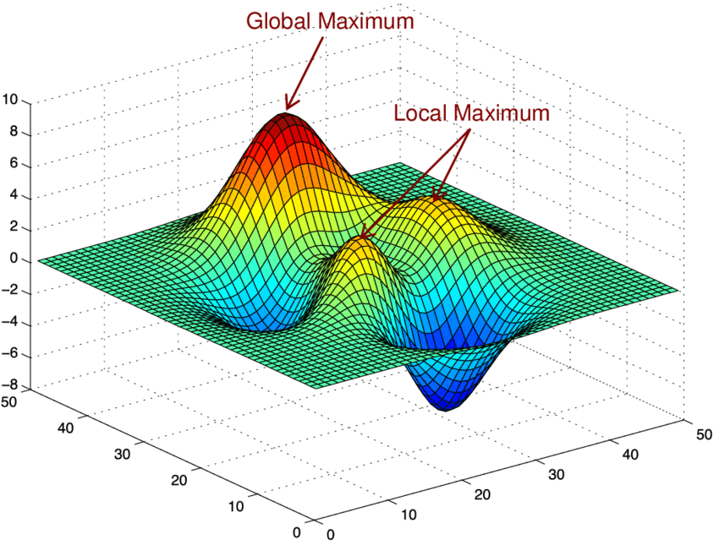
Greedy Algorithms
5
4
10
100
45
25
15
https://images.app.goo.gl/nehZPYDjn3LxjJey8
Notes:
Memoization –top down, call stack avoids some problems
Tabulation bottom up all subproblems 32 – 14, 8, 1

Slide 12
Greedy Algorithms
5
4
10
100
45
25
15
https://images.app.goo.gl/nehZPYDjn3LxjJey8
Notes:
Memoization –top down, call stack avoids some problems
Tabulation bottom up all subproblems 32 – 14, 8, 1

Slide 13

Coin Change
Make change with the smallest number of coins.
Example: 32 cents
Quarters (0.25)
Dimes (0.10)
Nickels (0.05)
Pennies (0.01)
Notes:
32 – 14, 8, 1 non compositionality

Slide 14
Coin Change
Make change with the smallest number of coins.
Start with the largest denomination and dispense as many of those fit.
Example: 32 cents
Quarters (0.25)
Dimes (0.10)
Nickels (0.05)
Pennies (0.01)
Notes:
32 – 14, 8, 1 non compositionality

Slide 15
Coin Change
Make change with the smallest number of coins.
Start with the largest denomination and dispense as many of those fit.
Example: 32 cents
Quarters (0.25) – 1
Dimes (0.10) – 0
Nickels (0.05) – 1
Pennies (0.01) – 2
= 4 coins, the minimum possible
Notes:
32 – 14, 8, 1 non compositionality

Slide 16
Coin Change
Make change with the smallest number of coins.
Start with the largest denomination and dispense as many of those fit.
Example: 32 cents
Quarters (0.25) – 1
Dimes (0.10) – 0
Nickels (0.05) – 1
Pennies (0.01) – 2
= 4 coins, the minimum possible
Example, alternate universe: 32 cents
Gryffindor (0.14)
Slytherin (0.08)
Hufflepuffs (0.01)
Notes:
32 – 14, 8, 1

Slide 17
Coin Change
Make change with the smallest number of coins.
Start with the largest denomination and dispense as many of those fit.
Example: 32 cents
Quarters (0.25) – 1
Dimes (0.10) – 0
Nickels (0.05) – 1
Pennies (0.01) – 2
= 4 coins, the minimum possible
Example, alternate universe: 32 cents
Gryffindor (0.14) – 2
Slytherin (0.08) – 0
Hufflepuffs (0.01) – 4
= 6 coins, not the minimum possible as 4 Slytherins is global optimal
Notes:
32 – 14, 8, 1

Slide 18
Coin Change
Make change with the smallest number of coins.
Start with the largest denomination and dispense as many of those fit.
Example: 32 cents
Quarters (0.25) – 1
Dimes (0.10) – 0
Nickels (0.05) – 1
Pennies (0.01) – 2
= 4 coins, the minimum possible
Example, alternate universe: 32 cents
Gryffindor (0.14) – 2
Slytherin (0.08) – 0
Hufflepuffs (0.01) – 4
= 6 coins, not the minimum possible as 4 Slytherins is global optimal
A coin system is called "canonical" if the greedy algorithm always solves change-making optimally. It is possible to test whether a coin system is canonical in polynomial time.
Notes:
32 – 14, 8, 1

Slide 19
Bin Packing
If we have boxes that each require 14 units, 16 units, 4 units and 6 units of space, how many minimum bins are required to store all the four boxes if each bin can take at most 20 units of space using the following Greedy strategies
Notes:
32 – 14, 8, 1

Slide 20
Bin Packing
If we have boxes that each require 14 units, 16 units, 4 units and 6 units of space, how many minimum bins are required to store all the four boxes if each bin can take at most 20 units of space using the following Greedy strategies
First Fit: scan the bins and place the new item in the first bin that is large enough.
Best Fit: scan the bins and place the new item in the bin that finds the spot that creates the smallest empty space
Notes:
32 – 14, 8, 1

Slide 21
Bin Packing
If we have boxes that each require 14 units, 16 units, 4 units and 6 units of space, how many minimum bins are required to store all the four boxes if each bin can take at most 20 units of space using the following Greedy strategies
First Fit: scan the bins and place the new item in the first bin that is large enough.
Best Fit: scan the bins and place the new item in the bin that finds the spot that creates the smallest empty space
4
14
16
6
6
4
14
16
Notes:
32 – 14, 8, 1

Slide 22
Bin Packing
If we have boxes that each require 6 units, 3 units, 7 units, 2 units, and 2 units of space, how many minimum bins are required to store all the five boxes if each bin can take at most 10 units of space using the following Greedy strategies
First Fit: scan the bins and place the new item in the first bin that is large enough.
Best Fit: scan the bins and place the new item in the bin that finds the spot that creates the smallest empty space
Notes:
32 – 14, 8, 1

Slide 23
Bin Packing
If we have boxes that each require 6 units, 3 units, 7 units, 2 units, and 2 units of space, how many minimum bins are required to store all the five boxes if each bin can take at most 10 units of space using the following Greedy strategies
First Fit: scan the bins and place the new item in the first bin that is large enough.
Best Fit: scan the bins and place the new item in the bin that finds the spot that creates the smallest empty space
3
2
6
7
2
3
2
6
7
2
Notes:
32 – 14, 8, 1

Slide 24
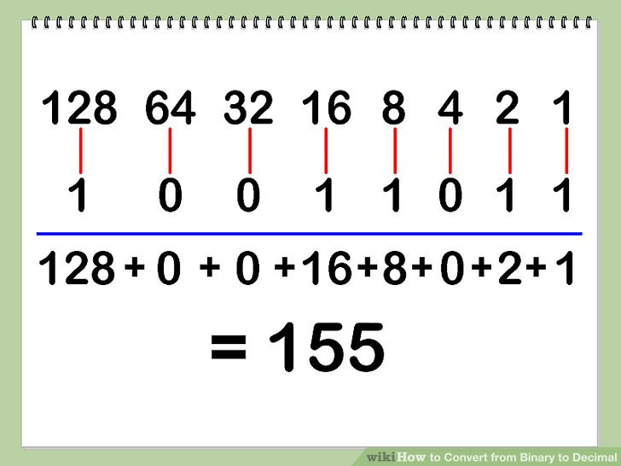
Greedy Algorithm for Converting Decimal to Binary
Convert decimal to binary.
Start with the largest power of two that will fit.
Assign 1 to that place. Subtract that value.
Repeat.
Example: 280
2⁸ = 256
ninth significant digit = 1
100000000
280-256= 24
2⁴ = 16
fifth significant digit = 1
100010000
24-16=8
2³ = 8
fourth significant digit = 1
100011000
8-8 = 0, done
Notes:
32 – 14, 8, 1

Slide 25
Huffman Trees
Notes:
Hi everyone, welcome to the second module of the course

Slide 26
Rationale
How is text transmitted?
How many bits we need to encode a character?
Notes:
In the last lecture we covered BFS and DFS and today we will continue with some applications of these traversals in common problem.

Slide 27
Rationale
How is text transmitted?
1’s and 0’s
How many bits we need to encode a character?
⎡ log₂ n ⎤
Notes:
In the last lecture we covered BFS and DFS and today we will continue with some applications of these traversals in common problem.

Slide 28
Rationale
How is text transmitted? : mississippi
How many bits we need to encode a character?
⎡ log₂ 4 ⎤ = 2 bits per character
11 * 2 = 22 bits to transmit “mississippi"
Notes:
In the last lecture we covered BFS and DFS and today we will continue with some applications of these traversals in common problem.

Slide 29
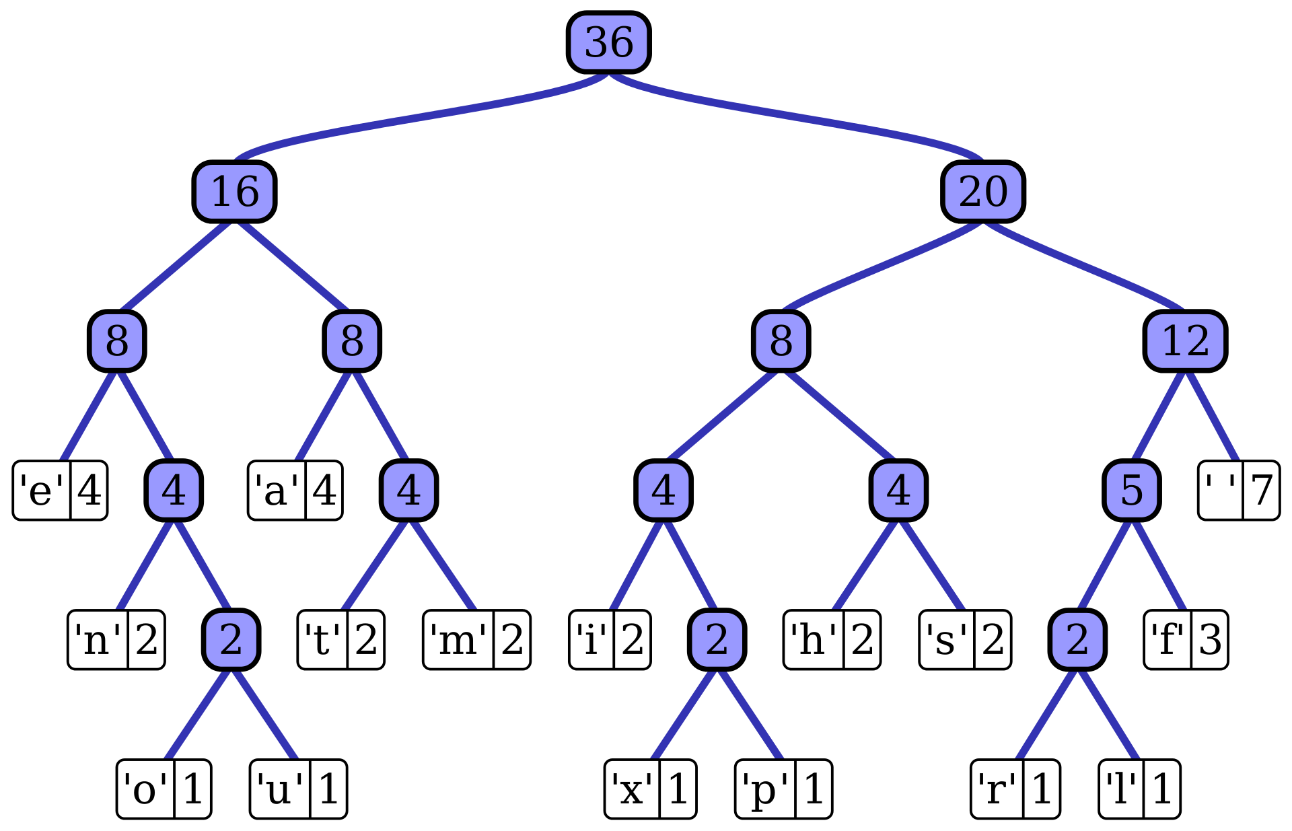
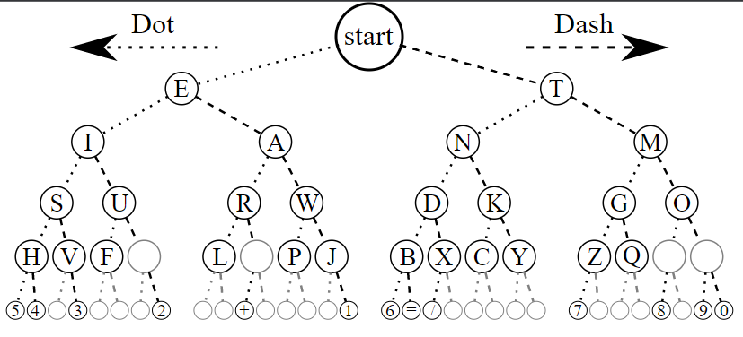
Huffman Encoding
Huffman Encoding uses prefix-free codes (no codeword is a prefix of another). A prefix code is a uniquely decodable code; given a complete and accurate sequence, a receiver can identify each word without requiring a special marker between words.
Prefix free
Not Prefix free
https://en.wikipedia.org/wiki/Huffman_coding#/media/File:Huffman_tree_2.svg
https://commons.wikimedia.org/wiki/File:Morse-code-tree.svg
Notes:
In the last lecture we covered BFS and DFS and today we will continue with some applications of these traversals in common problem.

Slide 30
Algorithm for Huffman Encoding
1. Create a table with symbols and their frequencies
mississippi
Character | Frequency
m | 1
i | 4
s | 4
p | 2
Notes:
In the last lecture we covered BFS and DFS and today we will continue with some applications of these traversals in common problem.

Slide 31
Algorithm for Huffman Encoding
2. Construct a set of trees with root nodes that contain each of the individual
symbols and their weight (frequency).
3. Place the set of trees into a priority queue.
mississippi
Character | Frequency
m | 1
i | 4
s | 4
p | 2
m:1
p:2
s:4
i:4
Notes:
In the last lecture we covered BFS and DFS and today we will continue with some applications of these traversals in common problem.

Slide 32
Algorithm for Huffman Encoding
4. while the priority queue has more than one item
Remove the two trees with the smallest weights.
Combine them into a new binary tree in which the weight of the tree
root is the sum of the weights of its children.
Insert the newly created tree back into the priority queue.
mississippi
Character | Frequency
m | 1
i | 4
s | 4
p | 2
m:1
p:2
s:4
i:4
Notes:
In the last lecture we covered BFS and DFS and today we will continue with some applications of these traversals in common problem.

Slide 33
Algorithm for Huffman Encoding
4. while the priority queue has more than one item
Remove the two trees with the smallest weights.
Combine them into a new binary tree in which the weight of the tree
root is the sum of the weights of its children.
Insert the newly created tree back into the priority queue.
3
mississippi
Character | Frequency
m | 1
i | 4
s | 4
p | 2
m:1
p:2
s:4
i:4
Notes:
In the last lecture we covered BFS and DFS and today we will continue with some applications of these traversals in common problem.

Slide 34
Algorithm for Huffman Encoding
4. while the priority queue has more than one item
Remove the two trees with the smallest weights.
Combine them into a new binary tree in which the weight of the tree
root is the sum of the weights of its children.
Insert the newly created tree back into the priority queue.
mississippi
Character | Frequency
m | 1
i | 4
s | 4
p | 2
3
s:4
i:4
m:1
p:2
Notes:
In the last lecture we covered BFS and DFS and today we will continue with some applications of these traversals in common problem.

Slide 35
Algorithm for Huffman Encoding
4. while the priority queue has more than one item
Remove the two trees with the smallest weights.
Combine them into a new binary tree in which the weight of the tree
root is the sum of the weights of its children.
Insert the newly created tree back into the priority queue.
mississippi
Character | Frequency
m | 1
i | 4
s | 4
p | 2
3
s:4
i:4
m:1
p:2
Notes:
In the last lecture we covered BFS and DFS and today we will continue with some applications of these traversals in common problem.

Slide 36
Algorithm for Huffman Encoding
4. while the priority queue has more than one item
Remove the two trees with the smallest weights.
Combine them into a new binary tree in which the weight of the tree
root is the sum of the weights of its children.
Insert the newly created tree back into the priority queue.
mississippi
Character | Frequency
m | 1
i | 4
s | 4
p | 2
3
s:4
i:4
m:1
p:2
Notes:
In the last lecture we covered BFS and DFS and today we will continue with some applications of these traversals in common problem.

Slide 37
Algorithm for Huffman Encoding
4. while the priority queue has more than one item
Remove the two trees with the smallest weights.
Combine them into a new binary tree in which the weight of the tree
root is the sum of the weights of its children.
Insert the newly created tree back into the priority queue.
mississippi
7
Character | Frequency
m | 1
i | 4
s | 4
p | 2
3
s:4
i:4
m:1
p:2
Notes:
In the last lecture we covered BFS and DFS and today we will continue with some applications of these traversals in common problem.

Slide 38
Algorithm for Huffman Encoding
4. while the priority queue has more than one item
Remove the two trees with the smallest weights.
Combine them into a new binary tree in which the weight of the tree
root is the sum of the weights of its children.
Insert the newly created tree back into the priority queue.
mississippi
i:4
7
Character | Frequency
m | 1
i | 4
s | 4
p | 2
3
s:4
m:1
p:2
Notes:
In the last lecture we covered BFS and DFS and today we will continue with some applications of these traversals in common problem.

Slide 39
Algorithm for Huffman Encoding
4. while the priority queue has more than one item
Remove the two trees with the smallest weights.
Combine them into a new binary tree in which the weight of the tree
root is the sum of the weights of its children.
Insert the newly created tree back into the priority queue.
11
mississippi
Character | Frequency
m | 1
i | 4
s | 4
p | 2
i:4
7
3
s:4
m:1
p:2
Notes:
In the last lecture we covered BFS and DFS and today we will continue with some applications of these traversals in common problem.

Slide 40
Algorithm for Huffman Encoding
4. while the priority queue has more than one item
Remove the two trees with the smallest weights.
Combine them into a new binary tree in which the weight of the tree
root is the sum of the weights of its children.
Insert the newly created tree back into the priority queue.
11
mississippi
Character | Frequency
m | 1
i | 4
s | 4
p | 2
i:4
7
3
s:4
m:1
p:2
Notes:
In the last lecture we covered BFS and DFS and today we will continue with some applications of these traversals in common problem.

Slide 41
Algorithm for Huffman Encoding
5. Traverse the resulting tree to obtain binary codes for characters: 0 towards left, 1 to towards right
11
mississippi
Character | Frequency | Code | Bits per Code
m | 1 | 100 | 3
i | 4 | 0 | 1
s | 4 | 11 | 2
p | 2 | 101 | 3
i:4
7
3
s:4
m:1
p:2
Notes:
In the last lecture we covered BFS and DFS and today we will continue with some applications of these traversals in common problem.

Slide 42
Algorithm for Huffman Encoding
5. Traverse the resulting tree to obtain binary codes for characters: 0 towards left, 1 to towards right
11
mississippi
Character | Frequency | Code | Bits per Code
m | 1 | 100 | 3
i | 4 | 0 | 1
s | 4 | 11 | 2
p | 2 | 101 | 3
i:4
7
3
s:4
m:1
p:2
Total bits for “mississippi” =
1*3 + 4*1 + 4*2 + 2*3 = 21 bits
Compression: 21/22 ~ 95.5%
Notes:
In the last lecture we covered BFS and DFS and today we will continue with some applications of these traversals in common problem.

Slide 43
Algorithm for Huffman Encoding
11
What if there were 1 million succeeding ‘i’ in “mississippi”?
mississippi...
i:1m
7
Character | Frequency | Code | Bits per Code
m | 1 | 100 | 3
i | 1,000,004 | 0 | 1
s | 4 | 11 | 2
p | 2 | 101 | 3
3
s:4
m:1
p:2
Total bits for “mississippi….” = 1*3 + 1000004*1 + 4*2 + 2*3 = 1,000,021 bits [Huffman codes]
Total bits for “mississippi….” through regular transmission = 1000011*2 = 2,000,022 bits
Compression: 1000021/2000022 ~ 50%
Notes:
In the last lecture we covered BFS and DFS and today we will continue with some applications of these traversals in common problem.

Slide 44
Algorithm for Huffman Encoding: Interface
class huffman_tree
{
private:
//add your data structures here
public:
/*
Preconditions: input is a string of characters with ascii values 0-127
Postconditions: reads the characters of input and constructs a
huffman tree based on the character frequencies of the file contents
*/
huffman_tree(const string& input) {}
/*
Preconditions: input is a character with ascii value between 0-127
Postconditions: returns the Huffman code for character if character
is in the tree and an empty string otherwise.
*/
string get_character_code(char character) const { return ""; }
/*
Preconditions: input is a string of characters with ascii values 0-127
Postconditions: returns the Huffman encoding for the contents of
file_name if file name exists and an empty string
otherwise. If the file contains letters not present in the
huffman_tree, return an empty string
*/
string encode(const string& input) const { return ""; }
/*
Preconditions: string_to_decode is a string containing Huffman-encoded text
Postconditions: returns the plaintext represented by the string if the string
is a valid Huffman encoding and an empty string otherwise
*/
string decode(const string& string_to_decode) const { return ""; }
};
Notes:
In the last lecture we covered BFS and DFS and today we will continue with some applications of these traversals in common problem.

Slide 45
Questions
Notes:
In an undirected graph a cycle must contain at least three distinct vertices

Slide 46

Mentimeter
Code
6498 872
Notes:
We have seen sorting already: Heap sort, inorder of trees

Slide 47
Dynamic Programming
Notes:
Hi everyone, welcome to the second module of the course

Slide 48
Dynamic Programming
Top-down DP: Memoization
Bottom-up DP: Tabulation
Notes:
In an undirected graph a cycle must contain at least three distinct vertices

Slide 49
Fibonacci Sequence
int standardFibonacci(int n)
{
if (n <= 1)
return n;
return standardFibonacci(n-1) + standardFibonacci(n-2);
}
https://onlinegdb.com/S1VSAMjUu
Notes:
In an undirected graph a cycle must contain at least three distinct vertices

Slide 50
Fibonacci Sequence
int standardFibonacci(int n)
{
if (n <= 1)
return n;
return standardFibonacci(n-1) + standardFibonacci(n-2);
}
Time Complexity:
Space Complexity:
https://onlinegdb.com/S1VSAMjUu
Notes:
In an undirected graph a cycle must contain at least three distinct vertices

Slide 51
Fibonacci Sequence
int standardFibonacci(int n)
{
if (n <= 1)
return n;
return standardFibonacci(n-1) + standardFibonacci(n-2);
}
Time Complexity: O(2^{n})
Space Complexity: O(n)
https://onlinegdb.com/S1VSAMjUu
Notes:
In an undirected graph a cycle must contain at least three distinct vertices

Slide 52
Fibonacci Sequence: Tabulation
int bottomUpDPFibonacci(int n)
{
vector<int> dp(n+1);
dp[0] = 0;
dp[1] = 1;
for (int i = 2; i <= n; i++)
dp[i] = dp[i - 1] + dp[i - 2];
return dp[n];
}
https://onlinegdb.com/S1VSAMjUu
Notes:
In an undirected graph a cycle must contain at least three distinct vertices

Slide 53
Fibonacci Sequence: Tabulation
int bottomUpDPFibonacci(int n)
{
vector<int> dp(n+1);
dp[0] = 0;
dp[1] = 1;
for (int i = 2; i <= n; i++)
dp[i] = dp[i - 1] + dp[i - 2];
return dp[n];
}
Time Complexity:
Space Complexity:
https://onlinegdb.com/S1VSAMjUu
Notes:
In an undirected graph a cycle must contain at least three distinct vertices

Slide 54
Fibonacci Sequence: Tabulation
int bottomUpDPFibonacci(int n)
{
vector<int> dp(n+1);
dp[0] = 0;
dp[1] = 1;
for (int i = 2; i <= n; i++)
dp[i] = dp[i - 1] + dp[i - 2];
return dp[n];
}
Time Complexity: O(n)
Space Complexity: O(n)
https://onlinegdb.com/S1VSAMjUu
Notes:
In an undirected graph a cycle must contain at least three distinct vertices

Slide 55
Fibonacci Sequence: Memoization
int fib(vector<int> &dp, int n)
{
if (n <= 1)
return n;
if (dp.at(n) != 0)
return dp.at(n);
dp.at(n) = fib(dp, n - 1) + fib(dp, n - 2);
return dp.at(n);
}
int topDownDPFibonacci(int n)
{
vector<int> dp(n + 1, 0);
return fib(dp, n);
}
https://onlinegdb.com/S1VSAMjUu
Notes:
In an undirected graph a cycle must contain at least three distinct vertices

Slide 56
Fibonacci Sequence: Memoization
int fib(vector<int> &dp, int n)
{
if (n <= 1)
return n;
if (dp.at(n) != 0)
return dp.at(n);
dp.at(n) = fib(dp, n - 1) + fib(dp, n - 2);
return dp.at(n);
}
int mFibonacci(int n)
{
vector<int> dp(n + 1, 0);
return fib(dp, n);
}
int main()
{
mFibonacci(5);
return 0;
}
0 | 0 | 0 | 0 | 0 | 0
0 | 1 | 2 | 3 | 4 | 5
dp
https://onlinegdb.com/S1VSAMjUu
Notes:
In an undirected graph a cycle must contain at least three distinct vertices

Slide 57
Fibonacci Sequence: Memoization
int fib(vector<int> &dp, int n)
{
if (n <= 1)
return n;
if (dp.at(n) != 0)
return dp.at(n);
dp.at(n) = fib(dp, n - 1) + fib(dp, n - 2);
return dp.at(n);
}
int mFibonacci(int n)
{
vector<int> dp(n + 1, 0);
return fib(dp, n);
}
int main()
{
mFibonacci(5);
return 0;
}
main()
0 | 0 | 0 | 0 | 0 | 0
0 | 1 | 2 | 3 | 4 | 5
dp
https://onlinegdb.com/S1VSAMjUu
Notes:
In an undirected graph a cycle must contain at least three distinct vertices

Slide 58
Fibonacci Sequence: Memoization
int fib(vector<int> &dp, int n)
{
if (n <= 1)
return n;
if (dp.at(n) != 0)
return dp.at(n);
dp.at(n) = fib(dp, n - 1) + fib(dp, n - 2);
return dp.at(n);
}
int mFibonacci(int n)
{
vector<int> dp(n + 1, 0);
return fib(dp, n);
}
mFibonacci(5)
int main()
{
mFibonacci(5);
return 0;
}
main()
0 | 0 | 0 | 0 | 0 | 0
0 | 1 | 2 | 3 | 4 | 5
dp
https://onlinegdb.com/S1VSAMjUu
Notes:
In an undirected graph a cycle must contain at least three distinct vertices

Slide 59
Fibonacci Sequence: Memoization
int fib(vector<int> &dp, int n)
{
if (n <= 1)
return n;
if (dp.at(n) != 0)
return dp.at(n);
dp.at(n) = fib(dp, n - 1) + fib(dp, n - 2);
return dp.at(n);
}
int mFibonacci(int n)
{
vector<int> dp(n + 1, 0);
return fib(dp, n);
}
fib(dp, 5)
mFibonacci(5)
int main()
{
mFibonacci(5);
return 0;
}
main()
0 | 0 | 0 | 0 | 0 | 0
0 | 1 | 2 | 3 | 4 | 5
dp
https://onlinegdb.com/S1VSAMjUu
Notes:
In an undirected graph a cycle must contain at least three distinct vertices

Slide 60
Fibonacci Sequence: Memoization
int fib(vector<int> &dp, int n)
{
if (n <= 1)
return n;
if (dp.at(n) != 0)
return dp.at(n);
dp.at(n) = fib(dp, n - 1) + fib(dp, n - 2);
return dp.at(n);
}
int mFibonacci(int n)
{
vector<int> dp(n + 1, 0);
return fib(dp, n);
}
fib(dp, 5)
int fib(dp, 5)
{
if (n <= 1)
return n;
if (dp.at(n) != 0)
return dp.at(n);
dp.at(n) = fib(dp, n - 1) + fib(dp, n - 2);
return dp.at(n);
}
mFibonacci(5)
int main()
{
mFibonacci(5);
return 0;
}
main()
0 | 0 | 0 | 0 | 0 | 0
0 | 1 | 2 | 3 | 4 | 5
dp
https://onlinegdb.com/S1VSAMjUu
Notes:
In an undirected graph a cycle must contain at least three distinct vertices

Slide 61
Fibonacci Sequence: Memoization
int fib(vector<int> &dp, int n)
{
if (n <= 1)
return n;
if (dp.at(n) != 0)
return dp.at(n);
dp.at(n) = fib(dp, n - 1) + fib(dp, n - 2);
return dp.at(n);
}
int mFibonacci(int n)
{
vector<int> dp(n + 1, 0);
return fib(dp, n);
}
fib(dp, 4)
fib(dp, 5)
int fib(dp, 5)
{
if (n <= 1)
return n;
if (dp.at(n) != 0)
return dp.at(n);
dp.at(n) = fib(dp, n - 1) + fib(dp, n - 2);
return dp.at(n);
}
mFibonacci(5)
int main()
{
mFibonacci(5);
return 0;
}
main()
0 | 0 | 0 | 0 | 0 | 0
0 | 1 | 2 | 3 | 4 | 5
dp
https://onlinegdb.com/S1VSAMjUu
Notes:
In an undirected graph a cycle must contain at least three distinct vertices

Slide 62
Fibonacci Sequence: Memoization
int fib(vector<int> &dp, int n)
{
if (n <= 1)
return n;
if (dp.at(n) != 0)
return dp.at(n);
dp.at(n) = fib(dp, n - 1) + fib(dp, n - 2);
return dp.at(n);
}
int fib(dp, 4)
{
if (n <= 1)
return n;
if (dp.at(n) != 0)
return dp.at(n);
dp.at(n) = fib(dp, n - 1) + fib(dp, n - 2);
return dp.at(n);
}
int mFibonacci(int n)
{
vector<int> dp(n + 1, 0);
return fib(dp, n);
}
fib(dp, 4)
fib(dp, 5)
int fib(dp, 5)
{
if (n <= 1)
return n;
if (dp.at(n) != 0)
return dp.at(n);
dp.at(n) = fib(dp, n - 1) + fib(dp, n - 2);
return dp.at(n);
}
mFibonacci(5)
int main()
{
mFibonacci(5);
return 0;
}
main()
0 | 0 | 0 | 0 | 0 | 0
0 | 1 | 2 | 3 | 4 | 5
dp
https://onlinegdb.com/S1VSAMjUu
Notes:
In an undirected graph a cycle must contain at least three distinct vertices

Slide 63
Fibonacci Sequence: Memoization
int fib(vector<int> &dp, int n)
{
if (n <= 1)
return n;
if (dp.at(n) != 0)
return dp.at(n);
dp.at(n) = fib(dp, n - 1) + fib(dp, n - 2);
return dp.at(n);
}
int mFibonacci(int n)
{
vector<int> dp(n + 1, 0);
return fib(dp, n);
}
fib(dp, 4)
int fib(dp, 4)
{
if (n <= 1)
return n;
if (dp.at(n) != 0)
return dp.at(n);
dp.at(n) = fib(dp, n - 1) + fib(dp, n - 2);
return dp.at(n);
}
fib(dp, 5)
mFibonacci(5)
int fib(dp, 5)
{
if (n <= 1)
return n;
if (dp.at(n) != 0)
return dp.at(n);
dp.at(n) = fib(dp, n - 1) + fib(dp, n - 2);
return dp.at(n);
}
int main()
{
mFibonacci(5);
return 0;
}
main()
0 | 0 | 0 | 0 | 0 | 0
0 | 1 | 2 | 3 | 4 | 5
dp
https://onlinegdb.com/S1VSAMjUu
Notes:
In an undirected graph a cycle must contain at least three distinct vertices

Slide 64
Fibonacci Sequence: Memoization
int fib(vector<int> &dp, int n)
{
if (n <= 1)
return n;
if (dp.at(n) != 0)
return dp.at(n);
dp.at(n) = fib(dp, n - 1) + fib(dp, n - 2);
return dp.at(n);
}
int fib(dp, 3)
{
if (n <= 1)
return n;
if (dp.at(n) != 0)
return dp.at(n);
dp.at(n) = fib(dp, n - 1) + fib(dp, n - 2);
return dp.at(n);
}
fib(dp, 3)
int mFibonacci(int n)
{
vector<int> dp(n + 1, 0);
return fib(dp, n);
}
fib(dp, 4)
int fib(dp, 4)
{
if (n <= 1)
return n;
if (dp.at(n) != 0)
return dp.at(n);
dp.at(n) = fib(dp, n - 1) + fib(dp, n - 2);
return dp.at(n);
}
fib(dp, 5)
mFibonacci(5)
int fib(dp, 5)
{
if (n <= 1)
return n;
if (dp.at(n) != 0)
return dp.at(n);
dp.at(n) = fib(dp, n - 1) + fib(dp, n - 2);
return dp.at(n);
}
int main()
{
mFibonacci(5);
return 0;
}
main()
0 | 0 | 0 | 0 | 0 | 0
0 | 1 | 2 | 3 | 4 | 5
dp
https://onlinegdb.com/S1VSAMjUu
Notes:
In an undirected graph a cycle must contain at least three distinct vertices

Slide 65
Fibonacci Sequence: Memoization
int fib(vector<int> &dp, int n)
{
if (n <= 1)
return n;
if (dp.at(n) != 0)
return dp.at(n);
dp.at(n) = fib(dp, n - 1) + fib(dp, n - 2);
return dp.at(n);
}
int fib(dp, 2)
{
if (n <= 1)
return n;
if (dp.at(n) != 0)
return dp.at(n);
dp.at(n) = fib(dp, n - 1) + fib(dp, n - 2);
return dp.at(n);
}
fib(dp, 2)
int fib(dp, 3)
{
if (n <= 1)
return n;
if (dp.at(n) != 0)
return dp.at(n);
dp.at(n) = fib(dp, n - 1) + fib(dp, n - 2);
return dp.at(n);
}
fib(dp, 3)
int mFibonacci(int n)
{
vector<int> dp(n + 1, 0);
return fib(dp, n);
}
fib(dp, 4)
int fib(dp, 4)
{
if (n <= 1)
return n;
if (dp.at(n) != 0)
return dp.at(n);
dp.at(n) = fib(dp, n - 1) + fib(dp, n - 2);
return dp.at(n);
}
fib(dp, 5)
mFibonacci(5)
int fib(dp, 5)
{
if (n <= 1)
return n;
if (dp.at(n) != 0)
return dp.at(n);
dp.at(n) = fib(dp, n - 1) + fib(dp, n - 2);
return dp.at(n);
}
int main()
{
mFibonacci(5);
return 0;
}
main()
0 | 0 | 0 | 0 | 0 | 0
0 | 1 | 2 | 3 | 4 | 5
dp
https://onlinegdb.com/S1VSAMjUu
Notes:
In an undirected graph a cycle must contain at least three distinct vertices

Slide 66
Fibonacci Sequence: Memoization
int fib(dp, 1)
{
if (n <= 1)
return n;
…
}
int fib(vector<int> &dp, int n)
{
if (n <= 1)
return n;
if (dp.at(n) != 0)
return dp.at(n);
dp.at(n) = fib(dp, n - 1) + fib(dp, n - 2);
return dp.at(n);
}
int fib(dp, 2)
{
if (n <= 1)
return n;
if (dp.at(n) != 0)
return dp.at(n);
dp.at(n) = fib(dp, n - 1) + fib(dp, n - 2);
return dp.at(n);
}
fib(dp, 1)
fib(dp, 2)
int fib(dp, 3)
{
if (n <= 1)
return n;
if (dp.at(n) != 0)
return dp.at(n);
dp.at(n) = fib(dp, n - 1) + fib(dp, n - 2);
return dp.at(n);
}
fib(dp, 3)
int mFibonacci(int n)
{
vector<int> dp(n + 1, 0);
return fib(dp, n);
}
fib(dp, 4)
int fib(dp, 4)
{
if (n <= 1)
return n;
if (dp.at(n) != 0)
return dp.at(n);
dp.at(n) = fib(dp, n - 1) + fib(dp, n - 2);
return dp.at(n);
}
fib(dp, 5)
mFibonacci(5)
int fib(dp, 5)
{
if (n <= 1)
return n;
if (dp.at(n) != 0)
return dp.at(n);
dp.at(n) = fib(dp, n - 1) + fib(dp, n - 2);
return dp.at(n);
}
int main()
{
mFibonacci(5);
return 0;
}
main()
0 | 0 | 0 | 0 | 0 | 0
0 | 1 | 2 | 3 | 4 | 5
dp
https://onlinegdb.com/S1VSAMjUu
Notes:
In an undirected graph a cycle must contain at least three distinct vertices

Slide 67
Fibonacci Sequence: Memoization
1
int fib(vector<int> &dp, int n)
{
if (n <= 1)
return n;
if (dp.at(n) != 0)
return dp.at(n);
dp.at(n) = fib(dp, n - 1) + fib(dp, n - 2);
return dp.at(n);
}
int fib(dp, 2)
{
if (n <= 1)
return n;
if (dp.at(n) != 0)
return dp.at(n);
dp.at(n) = fib(dp, n - 1) + fib(dp, n - 2);
return dp.at(n);
}
fib(dp, 1)
fib(dp, 2)
int fib(dp, 3)
{
if (n <= 1)
return n;
if (dp.at(n) != 0)
return dp.at(n);
dp.at(n) = fib(dp, n - 1) + fib(dp, n - 2);
return dp.at(n);
}
fib(dp, 3)
int mFibonacci(int n)
{
vector<int> dp(n + 1, 0);
return fib(dp, n);
}
fib(dp, 4)
int fib(dp, 4)
{
if (n <= 1)
return n;
if (dp.at(n) != 0)
return dp.at(n);
dp.at(n) = fib(dp, n - 1) + fib(dp, n - 2);
return dp.at(n);
}
fib(dp, 5)
mFibonacci(5)
int fib(dp, 5)
{
if (n <= 1)
return n;
if (dp.at(n) != 0)
return dp.at(n);
dp.at(n) = fib(dp, n - 1) + fib(dp, n - 2);
return dp.at(n);
}
int main()
{
mFibonacci(5);
return 0;
}
main()
0 | 1 | 0 | 0 | 0 | 0
0 | 1 | 2 | 3 | 4 | 5
dp
https://onlinegdb.com/S1VSAMjUu
Notes:
In an undirected graph a cycle must contain at least three distinct vertices

Slide 68
Fibonacci Sequence: Memoization
int fib(vector<int> &dp, int n)
{
if (n <= 1)
return n;
if (dp.at(n) != 0)
return dp.at(n);
dp.at(n) = fib(dp, n - 1) + fib(dp, n - 2);
return dp.at(n);
}
int fib(dp, 2)
{
if (n <= 1)
return n;
if (dp.at(n) != 0)
return dp.at(n);
dp.at(n) = 1 + fib(dp, n - 2);
return dp.at(n);
}
fib(dp, 2)
int fib(dp, 3)
{
if (n <= 1)
return n;
if (dp.at(n) != 0)
return dp.at(n);
dp.at(n) = fib(dp, n - 1) + fib(dp, n - 2);
return dp.at(n);
}
fib(dp, 3)
int mFibonacci(int n)
{
vector<int> dp(n + 1, 0);
return fib(dp, n);
}
fib(dp, 4)
int fib(dp, 4)
{
if (n <= 1)
return n;
if (dp.at(n) != 0)
return dp.at(n);
dp.at(n) = fib(dp, n - 1) + fib(dp, n - 2);
return dp.at(n);
}
fib(dp, 5)
mFibonacci(5)
int fib(dp, 5)
{
if (n <= 1)
return n;
if (dp.at(n) != 0)
return dp.at(n);
dp.at(n) = fib(dp, n - 1) + fib(dp, n - 2);
return dp.at(n);
}
int main()
{
mFibonacci(5);
return 0;
}
main()
0 | 1 | 0 | 0 | 0 | 0
0 | 1 | 2 | 3 | 4 | 5
dp
https://onlinegdb.com/S1VSAMjUu
Notes:
In an undirected graph a cycle must contain at least three distinct vertices

Slide 69
Fibonacci Sequence: Memoization
int fib(dp, 0)
{
if (n <= 1)
return n;
…
}
int fib(vector<int> &dp, int n)
{
if (n <= 1)
return n;
if (dp.at(n) != 0)
return dp.at(n);
dp.at(n) = fib(dp, n - 1) + fib(dp, n - 2);
return dp.at(n);
}
int fib(dp, 2)
{
if (n <= 1)
return n;
if (dp.at(n) != 0)
return dp.at(n);
dp.at(n) = 1 + fib(dp, n - 2);
return dp.at(n);
}
fib(dp, 0)
fib(dp, 2)
int fib(dp, 3)
{
if (n <= 1)
return n;
if (dp.at(n) != 0)
return dp.at(n);
dp.at(n) = fib(dp, n - 1) + fib(dp, n - 2);
return dp.at(n);
}
fib(dp, 3)
int mFibonacci(int n)
{
vector<int> dp(n + 1, 0);
return fib(dp, n);
}
fib(dp, 4)
int fib(dp, 4)
{
if (n <= 1)
return n;
if (dp.at(n) != 0)
return dp.at(n);
dp.at(n) = fib(dp, n - 1) + fib(dp, n - 2);
return dp.at(n);
}
fib(dp, 5)
mFibonacci(5)
int fib(dp, 5)
{
if (n <= 1)
return n;
if (dp.at(n) != 0)
return dp.at(n);
dp.at(n) = fib(dp, n - 1) + fib(dp, n - 2);
return dp.at(n);
}
int main()
{
mFibonacci(5);
return 0;
}
main()
0 | 1 | 0 | 0 | 0 | 0
0 | 1 | 2 | 3 | 4 | 5
dp
https://onlinegdb.com/S1VSAMjUu
Notes:
In an undirected graph a cycle must contain at least three distinct vertices

Slide 70
Fibonacci Sequence: Memoization
0
int fib(vector<int> &dp, int n)
{
if (n <= 1)
return n;
if (dp.at(n) != 0)
return dp.at(n);
dp.at(n) = fib(dp, n - 1) + fib(dp, n - 2);
return dp.at(n);
}
int fib(dp, 2)
{
if (n <= 1)
return n;
if (dp.at(n) != 0)
return dp.at(n);
dp.at(n) = 1 + fib(dp, n - 2);
return dp.at(n);
}
fib(dp, 0)
fib(dp, 2)
int fib(dp, 3)
{
if (n <= 1)
return n;
if (dp.at(n) != 0)
return dp.at(n);
dp.at(n) = fib(dp, n - 1) + fib(dp, n - 2);
return dp.at(n);
}
fib(dp, 3)
int mFibonacci(int n)
{
vector<int> dp(n + 1, 0);
return fib(dp, n);
}
fib(dp, 4)
int fib(dp, 4)
{
if (n <= 1)
return n;
if (dp.at(n) != 0)
return dp.at(n);
dp.at(n) = fib(dp, n - 1) + fib(dp, n - 2);
return dp.at(n);
}
fib(dp, 5)
mFibonacci(5)
int fib(dp, 5)
{
if (n <= 1)
return n;
if (dp.at(n) != 0)
return dp.at(n);
dp.at(n) = fib(dp, n - 1) + fib(dp, n - 2);
return dp.at(n);
}
int main()
{
mFibonacci(5);
return 0;
}
main()
0 | 1 | 0 | 0 | 0 | 0
0 | 1 | 2 | 3 | 4 | 5
dp
https://onlinegdb.com/S1VSAMjUu
Notes:
In an undirected graph a cycle must contain at least three distinct vertices

Slide 71
Fibonacci Sequence: Memoization
int fib(vector<int> &dp, int n)
{
if (n <= 1)
return n;
if (dp.at(n) != 0)
return dp.at(n);
dp.at(n) = fib(dp, n - 1) + fib(dp, n - 2);
return dp.at(n);
}
int fib(dp, 2)
{
if (n <= 1)
return n;
if (dp.at(n) != 0)
return dp.at(n);
dp.at(n) = 1 + fib(dp, n - 2);
return dp.at(n);
}
fib(dp, 2)
int fib(dp, 3)
{
if (n <= 1)
return n;
if (dp.at(n) != 0)
return dp.at(n);
dp.at(n) = fib(dp, n - 1) + fib(dp, n - 2);
return dp.at(n);
}
fib(dp, 3)
int mFibonacci(int n)
{
vector<int> dp(n + 1, 0);
return fib(dp, n);
}
fib(dp, 4)
int fib(dp, 4)
{
if (n <= 1)
return n;
if (dp.at(n) != 0)
return dp.at(n);
dp.at(n) = fib(dp, n - 1) + fib(dp, n - 2);
return dp.at(n);
}
fib(dp, 5)
mFibonacci(5)
int fib(dp, 5)
{
if (n <= 1)
return n;
if (dp.at(n) != 0)
return dp.at(n);
dp.at(n) = fib(dp, n - 1) + fib(dp, n - 2);
return dp.at(n);
}
int main()
{
mFibonacci(5);
return 0;
}
main()
0 | 1 | 0 | 0 | 0 | 0
0 | 1 | 2 | 3 | 4 | 5
dp
https://onlinegdb.com/S1VSAMjUu
Notes:
In an undirected graph a cycle must contain at least three distinct vertices

Slide 72
Fibonacci Sequence: Memoization
int fib(vector<int> &dp, int n)
{
if (n <= 1)
return n;
if (dp.at(n) != 0)
return dp.at(n);
dp.at(n) = fib(dp, n - 1) + fib(dp, n - 2);
return dp.at(n);
}
int fib(dp, 2)
{
if (n <= 1)
return n;
if (dp.at(n) != 0)
return dp.at(n);
dp.at(n) = 1 + 0;
return dp.at(n);
}
fib(dp, 2)
int fib(dp, 3)
{
if (n <= 1)
return n;
if (dp.at(n) != 0)
return dp.at(n);
dp.at(n) = fib(dp, n - 1) + fib(dp, n - 2);
return dp.at(n);
}
fib(dp, 3)
int mFibonacci(int n)
{
vector<int> dp(n + 1, 0);
return fib(dp, n);
}
fib(dp, 4)
int fib(dp, 4)
{
if (n <= 1)
return n;
if (dp.at(n) != 0)
return dp.at(n);
dp.at(n) = fib(dp, n - 1) + fib(dp, n - 2);
return dp.at(n);
}
fib(dp, 5)
mFibonacci(5)
int fib(dp, 5)
{
if (n <= 1)
return n;
if (dp.at(n) != 0)
return dp.at(n);
dp.at(n) = fib(dp, n - 1) + fib(dp, n - 2);
return dp.at(n);
}
int main()
{
mFibonacci(5);
return 0;
}
main()
0 | 1 | 0 | 0 | 0 | 0
0 | 1 | 2 | 3 | 4 | 5
dp
https://onlinegdb.com/S1VSAMjUu
Notes:
In an undirected graph a cycle must contain at least three distinct vertices

Slide 73
Fibonacci Sequence: Memoization
int fib(vector<int> &dp, int n)
{
if (n <= 1)
return n;
if (dp.at(n) != 0)
return dp.at(n);
dp.at(n) = fib(dp, n - 1) + fib(dp, n - 2);
return dp.at(n);
}
1
fib(dp, 2)
int fib(dp, 3)
{
if (n <= 1)
return n;
if (dp.at(n) != 0)
return dp.at(n);
dp.at(n) = fib(dp, n - 1) + fib(dp, n - 2);
return dp.at(n);
}
fib(dp, 3)
int mFibonacci(int n)
{
vector<int> dp(n + 1, 0);
return fib(dp, n);
}
fib(dp, 4)
int fib(dp, 4)
{
if (n <= 1)
return n;
if (dp.at(n) != 0)
return dp.at(n);
dp.at(n) = fib(dp, n - 1) + fib(dp, n - 2);
return dp.at(n);
}
fib(dp, 5)
mFibonacci(5)
int fib(dp, 5)
{
if (n <= 1)
return n;
if (dp.at(n) != 0)
return dp.at(n);
dp.at(n) = fib(dp, n - 1) + fib(dp, n - 2);
return dp.at(n);
}
int main()
{
mFibonacci(5);
return 0;
}
main()
0 | 1 | 1 | 0 | 0 | 0
0 | 1 | 2 | 3 | 4 | 5
dp
https://onlinegdb.com/S1VSAMjUu
Notes:
In an undirected graph a cycle must contain at least three distinct vertices

Slide 74
Fibonacci Sequence: Memoization
int fib(vector<int> &dp, int n)
{
if (n <= 1)
return n;
if (dp.at(n) != 0)
return dp.at(n);
dp.at(n) = fib(dp, n - 1) + fib(dp, n - 2);
return dp.at(n);
}
int fib(dp, 3)
{
if (n <= 1)
return n;
if (dp.at(n) != 0)
return dp.at(n);
dp.at(n) = 1 + fib(dp, n - 2);
return dp.at(n);
}
fib(dp, 3)
int mFibonacci(int n)
{
vector<int> dp(n + 1, 0);
return fib(dp, n);
}
fib(dp, 4)
int fib(dp, 4)
{
if (n <= 1)
return n;
if (dp.at(n) != 0)
return dp.at(n);
dp.at(n) = fib(dp, n - 1) + fib(dp, n - 2);
return dp.at(n);
}
fib(dp, 5)
mFibonacci(5)
int fib(dp, 5)
{
if (n <= 1)
return n;
if (dp.at(n) != 0)
return dp.at(n);
dp.at(n) = fib(dp, n - 1) + fib(dp, n - 2);
return dp.at(n);
}
int main()
{
mFibonacci(5);
return 0;
}
main()
0 | 1 | 1 | 0 | 0 | 0
0 | 1 | 2 | 3 | 4 | 5
dp
https://onlinegdb.com/S1VSAMjUu
Notes:
In an undirected graph a cycle must contain at least three distinct vertices

Slide 75
Fibonacci Sequence: Memoization
int fib(vector<int> &dp, int n)
{
if (n <= 1)
return n;
if (dp.at(n) != 0)
return dp.at(n);
dp.at(n) = fib(dp, n - 1) + fib(dp, n - 2);
return dp.at(n);
}
int fib(dp, 1)
{
if (n <= 1)
return n;
….
}
fib(dp, 1)
int fib(dp, 3)
{
if (n <= 1)
return n;
if (dp.at(n) != 0)
return dp.at(n);
dp.at(n) = 1 + fib(dp, n - 2);
return dp.at(n);
}
fib(dp, 3)
int mFibonacci(int n)
{
vector<int> dp(n + 1, 0);
return fib(dp, n);
}
fib(dp, 4)
int fib(dp, 4)
{
if (n <= 1)
return n;
if (dp.at(n) != 0)
return dp.at(n);
dp.at(n) = fib(dp, n - 1) + fib(dp, n - 2);
return dp.at(n);
}
fib(dp, 5)
mFibonacci(5)
int fib(dp, 5)
{
if (n <= 1)
return n;
if (dp.at(n) != 0)
return dp.at(n);
dp.at(n) = fib(dp, n - 1) + fib(dp, n - 2);
return dp.at(n);
}
int main()
{
mFibonacci(5);
return 0;
}
main()
0 | 1 | 1 | 0 | 0 | 0
0 | 1 | 2 | 3 | 4 | 5
dp
https://onlinegdb.com/S1VSAMjUu
Notes:
In an undirected graph a cycle must contain at least three distinct vertices

Slide 76
Fibonacci Sequence: Memoization
int fib(vector<int> &dp, int n)
{
if (n <= 1)
return n;
if (dp.at(n) != 0)
return dp.at(n);
dp.at(n) = fib(dp, n - 1) + fib(dp, n - 2);
return dp.at(n);
}
1
fib(dp, 1)
int fib(dp, 3)
{
if (n <= 1)
return n;
if (dp.at(n) != 0)
return dp.at(n);
dp.at(n) = 1 + fib(dp, n - 2);
return dp.at(n);
}
fib(dp, 3)
int mFibonacci(int n)
{
vector<int> dp(n + 1, 0);
return fib(dp, n);
}
fib(dp, 4)
int fib(dp, 4)
{
if (n <= 1)
return n;
if (dp.at(n) != 0)
return dp.at(n);
dp.at(n) = fib(dp, n - 1) + fib(dp, n - 2);
return dp.at(n);
}
fib(dp, 5)
mFibonacci(5)
int fib(dp, 5)
{
if (n <= 1)
return n;
if (dp.at(n) != 0)
return dp.at(n);
dp.at(n) = fib(dp, n - 1) + fib(dp, n - 2);
return dp.at(n);
}
int main()
{
mFibonacci(5);
return 0;
}
main()
0 | 1 | 1 | 0 | 0 | 0
0 | 1 | 2 | 3 | 4 | 5
dp
https://onlinegdb.com/S1VSAMjUu
Notes:
In an undirected graph a cycle must contain at least three distinct vertices

Slide 77
Fibonacci Sequence: Memoization
int fib(vector<int> &dp, int n)
{
if (n <= 1)
return n;
if (dp.at(n) != 0)
return dp.at(n);
dp.at(n) = fib(dp, n - 1) + fib(dp, n - 2);
return dp.at(n);
}
int fib(dp, 3)
{
if (n <= 1)
return n;
if (dp.at(n) != 0)
return dp.at(n);
dp.at(n) = 1 + 1;
return dp.at(n);
}
fib(dp, 3)
int mFibonacci(int n)
{
vector<int> dp(n + 1, 0);
return fib(dp, n);
}
fib(dp, 4)
int fib(dp, 4)
{
if (n <= 1)
return n;
if (dp.at(n) != 0)
return dp.at(n);
dp.at(n) = fib(dp, n - 1) + fib(dp, n - 2);
return dp.at(n);
}
fib(dp, 5)
mFibonacci(5)
int fib(dp, 5)
{
if (n <= 1)
return n;
if (dp.at(n) != 0)
return dp.at(n);
dp.at(n) = fib(dp, n - 1) + fib(dp, n - 2);
return dp.at(n);
}
int main()
{
mFibonacci(5);
return 0;
}
main()
0 | 1 | 1 | 0 | 0 | 0
0 | 1 | 2 | 3 | 4 | 5
dp
https://onlinegdb.com/S1VSAMjUu
Notes:
In an undirected graph a cycle must contain at least three distinct vertices

Slide 78
Fibonacci Sequence: Memoization
int fib(vector<int> &dp, int n)
{
if (n <= 1)
return n;
if (dp.at(n) != 0)
return dp.at(n);
dp.at(n) = fib(dp, n - 1) + fib(dp, n - 2);
return dp.at(n);
}
fib(dp, 3)
2
int mFibonacci(int n)
{
vector<int> dp(n + 1, 0);
return fib(dp, n);
}
fib(dp, 4)
int fib(dp, 4)
{
if (n <= 1)
return n;
if (dp.at(n) != 0)
return dp.at(n);
dp.at(n) = fib(dp, n - 1) + fib(dp, n - 2);
return dp.at(n);
}
fib(dp, 5)
mFibonacci(5)
int fib(dp, 5)
{
if (n <= 1)
return n;
if (dp.at(n) != 0)
return dp.at(n);
dp.at(n) = fib(dp, n - 1) + fib(dp, n - 2);
return dp.at(n);
}
int main()
{
mFibonacci(5);
return 0;
}
main()
0 | 1 | 1 | 2 | 0 | 0
0 | 1 | 2 | 3 | 4 | 5
dp
https://onlinegdb.com/S1VSAMjUu
Notes:
In an undirected graph a cycle must contain at least three distinct vertices

Slide 79
Fibonacci Sequence: Memoization
int fib(vector<int> &dp, int n)
{
if (n <= 1)
return n;
if (dp.at(n) != 0)
return dp.at(n);
dp.at(n) = fib(dp, n - 1) + fib(dp, n - 2);
return dp.at(n);
}
int mFibonacci(int n)
{
vector<int> dp(n + 1, 0);
return fib(dp, n);
}
fib(dp, 4)
int fib(dp, 4)
{
if (n <= 1)
return n;
if (dp.at(n) != 0)
return dp.at(n);
dp.at(n) = 2 + fib(dp, n - 2);
return dp.at(n);
}
fib(dp, 5)
mFibonacci(5)
int fib(dp, 5)
{
if (n <= 1)
return n;
if (dp.at(n) != 0)
return dp.at(n);
dp.at(n) = fib(dp, n - 1) + fib(dp, n - 2);
return dp.at(n);
}
int main()
{
mFibonacci(5);
return 0;
}
main()
0 | 1 | 1 | 2 | 0 | 0
0 | 1 | 2 | 3 | 4 | 5
dp
https://onlinegdb.com/S1VSAMjUu
Notes:
In an undirected graph a cycle must contain at least three distinct vertices

Slide 80
Fibonacci Sequence: Memoization
int fib(vector<int> &dp, int n)
{
if (n <= 1)
return n;
if (dp.at(n) != 0)
return dp.at(n);
dp.at(n) = fib(dp, n - 1) + fib(dp, n - 2);
return dp.at(n);
}
int fib(dp, 2)
{
if (n <= 1)
return n;
if (dp.at(n) != 0)
return dp.at(n);
dp.at(n) = fib(dp, n - 1) + fib(dp, n - 2);
return dp.at(n);
}
fib(dp, 2)
int mFibonacci(int n)
{
vector<int> dp(n + 1, 0);
return fib(dp, n);
}
fib(dp, 4)
int fib(dp, 4)
{
if (n <= 1)
return n;
if (dp.at(n) != 0)
return dp.at(n);
dp.at(n) = 2 + fib(dp, n - 2);
return dp.at(n);
}
fib(dp, 5)
mFibonacci(5)
int fib(dp, 5)
{
if (n <= 1)
return n;
if (dp.at(n) != 0)
return dp.at(n);
dp.at(n) = fib(dp, n - 1) + fib(dp, n - 2);
return dp.at(n);
}
int main()
{
mFibonacci(5);
return 0;
}
main()
0 | 1 | 1 | 2 | 0 | 0
0 | 1 | 2 | 3 | 4 | 5
dp
https://onlinegdb.com/S1VSAMjUu
Notes:
In an undirected graph a cycle must contain at least three distinct vertices

Slide 81
Fibonacci Sequence: Memoization
int fib(vector<int> &dp, int n)
{
if (n <= 1)
return n;
if (dp.at(n) != 0)
return dp.at(n);
dp.at(n) = fib(dp, n - 1) + fib(dp, n - 2);
return dp.at(n);
}
int fib(dp, 2)
{
if (n <= 1)
return n;
if (dp.at(n) != 0)
return dp.at(n);
dp.at(n) = fib(dp, n - 1) + fib(dp, n - 2);
return dp.at(n);
}
fib(dp, 2)
int mFibonacci(int n)
{
vector<int> dp(n + 1, 0);
return fib(dp, n);
}
fib(dp, 4)
int fib(dp, 4)
{
if (n <= 1)
return n;
if (dp.at(n) != 0)
return dp.at(n);
dp.at(n) = 2 + fib(dp, n - 2);
return dp.at(n);
}
fib(dp, 5)
mFibonacci(5)
int fib(dp, 5)
{
if (n <= 1)
return n;
if (dp.at(n) != 0)
return dp.at(n);
dp.at(n) = fib(dp, n - 1) + fib(dp, n - 2);
return dp.at(n);
}
int main()
{
mFibonacci(5);
return 0;
}
main()
0 | 1 | 1 | 2 | 0 | 0
0 | 1 | 2 | 3 | 4 | 5
dp
https://onlinegdb.com/S1VSAMjUu
Notes:
In an undirected graph a cycle must contain at least three distinct vertices

Slide 82
Fibonacci Sequence: Memoization
int fib(vector<int> &dp, int n)
{
if (n <= 1)
return n;
if (dp.at(n) != 0)
return dp.at(n);
dp.at(n) = fib(dp, n - 1) + fib(dp, n - 2);
return dp.at(n);
}
fib(dp, 2)
1
int mFibonacci(int n)
{
vector<int> dp(n + 1, 0);
return fib(dp, n);
}
fib(dp, 4)
int fib(dp, 4)
{
if (n <= 1)
return n;
if (dp.at(n) != 0)
return dp.at(n);
dp.at(n) = 2 + fib(dp, n - 2);
return dp.at(n);
}
fib(dp, 5)
mFibonacci(5)
int fib(dp, 5)
{
if (n <= 1)
return n;
if (dp.at(n) != 0)
return dp.at(n);
dp.at(n) = fib(dp, n - 1) + fib(dp, n - 2);
return dp.at(n);
}
int main()
{
mFibonacci(5);
return 0;
}
main()
0 | 1 | 1 | 2 | 0 | 0
0 | 1 | 2 | 3 | 4 | 5
dp
https://onlinegdb.com/S1VSAMjUu
Notes:
In an undirected graph a cycle must contain at least three distinct vertices

Slide 83
Fibonacci Sequence: Memoization
int fib(vector<int> &dp, int n)
{
if (n <= 1)
return n;
if (dp.at(n) != 0)
return dp.at(n);
dp.at(n) = fib(dp, n - 1) + fib(dp, n - 2);
return dp.at(n);
}
int mFibonacci(int n)
{
vector<int> dp(n + 1, 0);
return fib(dp, n);
}
fib(dp, 4)
int fib(dp, 4)
{
if (n <= 1)
return n;
if (dp.at(n) != 0)
return dp.at(n);
dp.at(n) = 2 + 1;
return dp.at(n);
}
fib(dp, 5)
mFibonacci(5)
int fib(dp, 5)
{
if (n <= 1)
return n;
if (dp.at(n) != 0)
return dp.at(n);
dp.at(n) = fib(dp, n - 1) + fib(dp, n - 2);
return dp.at(n);
}
int main()
{
mFibonacci(5);
return 0;
}
main()
0 | 1 | 1 | 2 | 0 | 0
0 | 1 | 2 | 3 | 4 | 5
dp
https://onlinegdb.com/S1VSAMjUu
Notes:
In an undirected graph a cycle must contain at least three distinct vertices

Slide 84
Fibonacci Sequence: Memoization
int fib(vector<int> &dp, int n)
{
if (n <= 1)
return n;
if (dp.at(n) != 0)
return dp.at(n);
dp.at(n) = fib(dp, n - 1) + fib(dp, n - 2);
return dp.at(n);
}
int mFibonacci(int n)
{
vector<int> dp(n + 1, 0);
return fib(dp, n);
}
fib(dp, 4)
fib(dp, 5)
3
mFibonacci(5)
int fib(dp, 5)
{
if (n <= 1)
return n;
if (dp.at(n) != 0)
return dp.at(n);
dp.at(n) = fib(dp, n - 1) + fib(dp, n - 2);
return dp.at(n);
}
int main()
{
mFibonacci(5);
return 0;
}
main()
0 | 1 | 1 | 2 | 3 | 0
0 | 1 | 2 | 3 | 4 | 5
dp
https://onlinegdb.com/S1VSAMjUu
Notes:
In an undirected graph a cycle must contain at least three distinct vertices

Slide 85
Fibonacci Sequence: Memoization
int fib(vector<int> &dp, int n)
{
if (n <= 1)
return n;
if (dp.at(n) != 0)
return dp.at(n);
dp.at(n) = fib(dp, n - 1) + fib(dp, n - 2);
return dp.at(n);
}
int mFibonacci(int n)
{
vector<int> dp(n + 1, 0);
return fib(dp, n);
}
fib(dp, 5)
mFibonacci(5)
int fib(dp, 5)
{
if (n <= 1)
return n;
if (dp.at(n) != 0)
return dp.at(n);
dp.at(n) = fib(dp, n - 1) + fib(dp, n - 2);
return dp.at(n);
}
int main()
{
mFibonacci(5);
return 0;
}
main()
0 | 1 | 1 | 2 | 3 | 0
0 | 1 | 2 | 3 | 4 | 5
dp
https://onlinegdb.com/S1VSAMjUu
Notes:
In an undirected graph a cycle must contain at least three distinct vertices

Slide 86
Fibonacci Sequence: Memoization
int fib(vector<int> &dp, int n)
{
if (n <= 1)
return n;
if (dp.at(n) != 0)
return dp.at(n);
dp.at(n) = fib(dp, n - 1) + fib(dp, n - 2);
return dp.at(n);
}
int mFibonacci(int n)
{
vector<int> dp(n + 1, 0);
return fib(dp, n);
}
fib(dp, 5)
mFibonacci(5)
int fib(dp, 5)
{
if (n <= 1)
return n;
if (dp.at(n) != 0)
return dp.at(n);
dp.at(n) = 3 + fib(dp, n - 2);
return dp.at(n);
}
int main()
{
mFibonacci(5);
return 0;
}
main()
0 | 1 | 1 | 2 | 3 | 0
0 | 1 | 2 | 3 | 4 | 5
dp
https://onlinegdb.com/S1VSAMjUu
Notes:
In an undirected graph a cycle must contain at least three distinct vertices

Slide 87
Fibonacci Sequence: Memoization
int fib(vector<int> &dp, int n)
{
if (n <= 1)
return n;
if (dp.at(n) != 0)
return dp.at(n);
dp.at(n) = fib(dp, n - 1) + fib(dp, n - 2);
return dp.at(n);
}
int mFibonacci(int n)
{
vector<int> dp(n + 1, 0);
return fib(dp, n);
}
fib(dp, 3)
int fib(dp, 3)
{
if (n <= 1)
return n;
if (dp.at(n) != 0)
return dp.at(n);
…
}
fib(dp, 5)
mFibonacci(5)
int fib(dp, 5)
{
if (n <= 1)
return n;
if (dp.at(n) != 0)
return dp.at(n);
dp.at(n) = 3 + fib(dp, n - 2);
return dp.at(n);
}
int main()
{
mFibonacci(5);
return 0;
}
main()
0 | 1 | 1 | 2 | 3 | 0
0 | 1 | 2 | 3 | 4 | 5
dp
https://onlinegdb.com/S1VSAMjUu
Notes:
In an undirected graph a cycle must contain at least three distinct vertices

Slide 88
Fibonacci Sequence: Memoization
int fib(vector<int> &dp, int n)
{
if (n <= 1)
return n;
if (dp.at(n) != 0)
return dp.at(n);
dp.at(n) = fib(dp, n - 1) + fib(dp, n - 2);
return dp.at(n);
}
int mFibonacci(int n)
{
vector<int> dp(n + 1, 0);
return fib(dp, n);
}
fib(dp, 3)
fib(dp, 5)
2
mFibonacci(5)
int fib(dp, 5)
{
if (n <= 1)
return n;
if (dp.at(n) != 0)
return dp.at(n);
dp.at(n) = 3 + fib(dp, n - 2);
return dp.at(n);
}
int main()
{
mFibonacci(5);
return 0;
}
main()
0 | 1 | 1 | 2 | 3 | 0
0 | 1 | 2 | 3 | 4 | 5
dp
https://onlinegdb.com/S1VSAMjUu
Notes:
In an undirected graph a cycle must contain at least three distinct vertices

Slide 89
Fibonacci Sequence: Memoization
int fib(vector<int> &dp, int n)
{
if (n <= 1)
return n;
if (dp.at(n) != 0)
return dp.at(n);
dp.at(n) = fib(dp, n - 1) + fib(dp, n - 2);
return dp.at(n);
}
int mFibonacci(int n)
{
vector<int> dp(n + 1, 0);
return fib(dp, n);
}
fib(dp, 5)
mFibonacci(5)
int fib(dp, 5)
{
if (n <= 1)
return n;
if (dp.at(n) != 0)
return dp.at(n);
dp.at(n) = 3 + 2;
return dp.at(n);
}
int main()
{
mFibonacci(5);
return 0;
}
main()
0 | 1 | 1 | 2 | 3 | 5
0 | 1 | 2 | 3 | 4 | 5
dp
https://onlinegdb.com/S1VSAMjUu
Notes:
In an undirected graph a cycle must contain at least three distinct vertices

Slide 90
Fibonacci Sequence: Memoization
int fib(vector<int> &dp, int n)
{
if (n <= 1)
return n;
if (dp.at(n) != 0)
return dp.at(n);
dp.at(n) = fib(dp, n - 1) + fib(dp, n - 2);
return dp.at(n);
}
int mFibonacci(int n)
{
vector<int> dp(n + 1, 0);
return fib(dp, n);
}
mFibonacci(5)
int main()
{
mFibonacci(5);
return 0;
}
main()
0 | 1 | 1 | 2 | 3 | 5
0 | 1 | 2 | 3 | 4 | 5
dp
https://onlinegdb.com/S1VSAMjUu
Notes:
In an undirected graph a cycle must contain at least three distinct vertices

Slide 91
Fibonacci Sequence: Memoization
int fib(vector<int> &dp, int n)
{
if (n <= 1)
return n;
if (dp.at(n) != 0)
return dp.at(n);
dp.at(n) = fib(dp, n - 1) + fib(dp, n - 2);
return dp.at(n);
}
main()
mFibonacci(5)
fib(dp, 5)
fib(dp, 4)
fib(dp, 3)
int mFibonacci(int n)
{
vector<int> dp(n + 1, 0);
return fib(dp, n);
}
fib(dp, 2)
fib(dp, 1)
+ fib(dp, 0)
int main()
{
mFibonacci(5);
return 0;
}
0 | 1 | 1 | 2 | 3 | 5
0 | 1 | 2 | 3 | 4 | 5
dp
https://onlinegdb.com/S1VSAMjUu
Notes:
In an undirected graph a cycle must contain at least three distinct vertices

Slide 92
Fibonacci Sequence: Memoization
int fib(vector<int> &dp, int n)
{
if (n <= 1)
return n;
if (dp.at(n) != 0)
return dp.at(n);
dp.at(n) = fib(dp, n - 1) + fib(dp, n - 2);
return dp.at(n);
}
main()
mFibonacci(5)
+ fib(dp, 4)
fib(dp, 5)
+ fib(dp, 3)
fib(dp, 4)
fib(dp, 3)
+ fib(dp, 2)
int mFibonacci(int n)
{
vector<int> dp(n + 1, 0);
return fib(dp, n);
}
fib(dp, 2)
+ fib(dp, 1)
fib(dp, 1)
+ fib(dp, 0)
int main()
{
mFibonacci(5);
return 0;
}
0 | 1 | 1 | 2 | 3 | 5
0 | 1 | 2 | 3 | 4 | 5
dp
https://onlinegdb.com/S1VSAMjUu
Notes:
In an undirected graph a cycle must contain at least three distinct vertices

Slide 93
Fibonacci Sequence: Memoization
int fib(vector<int> &dp, int n)
{
if (n <= 1)
return n;
if (dp.at(n) != 0)
return dp.at(n);
dp.at(n) = fib(dp, n - 1) + fib(dp, n - 2);
return dp.at(n);
}
int topDownDPFibonacci(int n)
{
vector<int> dp(n + 1, 0);
return fib(dp, n);
}
Time Complexity:
Space Complexity:
https://onlinegdb.com/S1VSAMjUu
Notes:
In an undirected graph a cycle must contain at least three distinct vertices

Slide 94
Fibonacci Sequence: Memoization
int fib(vector<int> &dp, int n)
{
if (n <= 1)
return n;
if (dp.at(n) != 0)
return dp.at(n);
dp.at(n) = fib(dp, n - 1) + fib(dp, n - 2);
return dp.at(n);
}
int topDownDPFibonacci(int n)
{
vector<int> dp(n + 1, 0);
return fib(dp, n);
}
Time Complexity: O(n)
Space Complexity: O(n)
https://onlinegdb.com/S1VSAMjUu
Notes:
In an undirected graph a cycle must contain at least three distinct vertices

Slide 95
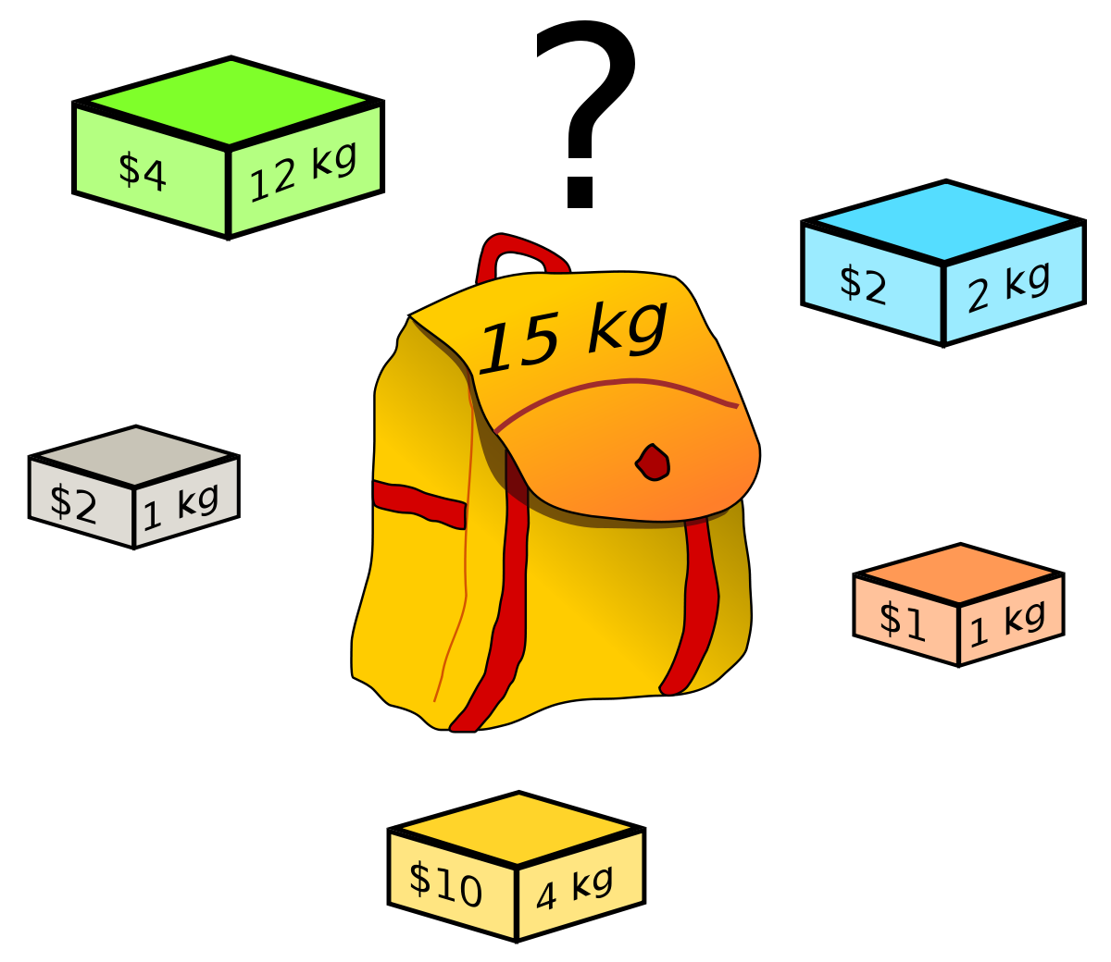
Knapsack Problem
One or more Constraints
Bounded / Unbounded / Fractional Items
One knapsack / more knapsacks
$1.2
https://images.app.goo.gl/vQejKPdsUynyp3As6
Notes:
In an undirected graph a cycle must contain at least three distinct vertices

Slide 96
0-1 Knapsack Problem
Items are bounded, non-fractional and only one knapsack allowed.
Maximize profit/value
https://images.app.goo.gl/vQejKPdsUynyp3As6
Notes:
In an undirected graph a cycle must contain at least three distinct vertices

Slide 97
0-1 Knapsack Problem
Items are bounded, non-fractional and only one knapsack allowed.
Maximize profit/value
Brute Force: 2^{N} combinations of sets for N-items in a Set
https://images.app.goo.gl/vQejKPdsUynyp3As6
Notes:
In an undirected graph a cycle must contain at least three distinct vertices

Slide 98
0-1 Knapsack Problem
Items are bounded, non-fractional and only one knapsack allowed.
Maximize profit/value
Brute Force: 2^{N} combinations of sets for N-items in a Set
Brute Force:
For every item, we have a choice –
Should we add this item or not?
Notes:
In an undirected graph a cycle must contain at least three distinct vertices

Slide 99
0-1 Knapsack Problem
Binary Rep. | Items | Weight of items | Value
000 | φ | 0 | 0
001 |  | 1 | 1
010 |  | 1 | 2
100 |  | 2 | 2
011 |  | 3 | 3
110 |  | 3 | 4
101 |  | 3 | 3
111 |  | 5 | 5
Items are bounded, non-fractional and only one knapsack allowed.
Maximize profit/value
Brute Force: 2^{N} combinations of sets for N-items in a Set
For example, if we had three items
Notes:
In an undirected graph a cycle must contain at least three distinct vertices

Slide 100
0-1 Knapsack Problem
Items are bounded, non-fractional and only one knapsack allowed.
Maximize profit/value
Brute Force: 2^{N} combinations of sets for N-items in a Set
For example, if we had five items
Number of combinations?
Notes:
In an undirected graph a cycle must contain at least three distinct vertices

Slide 101
0-1 Knapsack Problem
Binary Rep. | Items | Weight of items | Value
00000 | φ | 0 | 0
00001 |  | 1 | 1
00010 |  | 1 | 2
00100 |  | 2 | 2
01000 |  | 4 | 10
10000 |  | 12 | 4
. . . | . . . | . . . | . . .
11111 |  | 20 | 19
Items are bounded, non-fractional and only one knapsack allowed.
Maximize profit/value
Brute Force: 2^{N} combinations of sets for N-items in a Set
For example, if we had five items
Notes:
In an undirected graph a cycle must contain at least three distinct vertices

Slide 102
0-1 Knapsack Problem
Items are bounded, non-fractional and only one knapsack allowed.
Maximize profit/value
Greedy Algorithm?
https://images.app.goo.gl/vQejKPdsUynyp3As6
Notes:
In an undirected graph a cycle must contain at least three distinct vertices

Slide 103
Knapsack Problem
OPT(i, W) = optimal value of max weight subset that uses items 1, …, i with weight limit W
Greedy:
Repeatedly add item with maximum vi/wi ratio ….
Capacity M=7, Number of objects n = 3
w = [5, 4, 3]
v = [10, 7, 5] (ordered by vi/wi ratio)
https://images.app.goo.gl/vQejKPdsUynyp3As6
Notes:
In an undirected graph a cycle must contain at least three distinct vertices

Slide 104
Knapsack Problem
Dynamic Programming
Think about the following:
How can we break down the problem into smaller chunks?
What will happen when we have no items to choose from?
What will happen when we have one item to choose from?
What will happen when we have one item to choose from, but the weight of the item is more than the capacity of the knapsack?
Notes:
In an undirected graph a cycle must contain at least three distinct vertices

Slide 105
Knapsack Problem
Dynamic Programming
Think about the following:
How can we break down the problem into smaller chunks?
What will happen when we have no items to choose from?
What will happen when we have one item to choose from?
What will happen when we have one item to choose from, but the weight of the item is more than the capacity of the knapsack?
Mathematical representation of the problem
OPT(i, W) = optimal value of max weight subset that uses items 1, …, i with weight limit W (If we have i items and a Knapsack of capacity W, what is the optimal value?)
Notes:
In an undirected graph a cycle must contain at least three distinct vertices

Slide 106
Knapsack Problem
Dynamic Programming
Think about the following:
How can we break down the problem into smaller chunks?
What will happen when we have no items to choose from?
What will happen when we have one item to choose from?
What will happen when we have one item to choose from, but the weight of the item is more than the capacity of the knapsack?
Mathematical representation of the problem
OPT(i, W):
0 if i = 0
OPT(i - 1, W) if w_{i} > W_{K}
max(OPT(i - 1, W), v_{i} + OPT(i - 1, W - w_{i})) otherwise
Notes:
In an undirected graph a cycle must contain at least three distinct vertices

Slide 107
Knapsack Problem
OPT(i, W) = optimal value of max weight subset that uses items 1, …, i with weight limit W (If we have i items and a Knapsack of capacity W, what is the optimal value?)
Dynamic Programming
Case 1: item i is not included:
Take best of {1, 2, …., i-1} using weight limit W: OPT(i-1, W)
Case 2: item i with weight w_{i} and value v_{i} is included:
only possible if W > = w_{i}
new weight limit = W - w_{i}
Take best of {1, 2, ….., i-1} using weight limit W – w_{i} and add v_{i}:
OPT(i-1, W-w_{i}) + v_{i}
OPT(i, W):
0 if i = 0
OPT(i - 1, W) if w_{i} > W
max(OPT(i - 1, W), v_{i} + OPT(i - 1, W - w_{i})) otherwise
Notes:
In an undirected graph a cycle must contain at least three distinct vertices

Slide 108
Knapsack Problem
Weight of Knapsack, W = 2
Value (v_{i}) | Weight (w_{i})
10 | 1
20 | 1
30 | 1
OPT(i, W):
0 if i = 0
OPT(i - 1, W) if w_{i} > W
max(OPT(i - 1, W), v_{i} + OPT(i - 1, W - w_{i})) otherwise
OPT(i, W): optimal value of max weight subset that uses items 1, …, i with weight limit W
Notes:
In an undirected graph a cycle must contain at least three distinct vertices

Slide 109
Knapsack Problem
Grid Size
# rows: No. of items + 1
# columns: W + 1
Weight of Knapsack, W = 2
Value (v_{i}) | Weight (w_{i})
10 | 1
20 | 1
30 | 1
 | 0 | 1 | 2
{0}
{0, 1}
{0, 1, 2}
{0, 1, 2, 3}
OPT(i, W):
0 if i = 0
OPT(i - 1, W) if w_{i} > W
max(OPT(i - 1, W), v_{i} + OPT(i - 1, W - w_{i})) otherwise
OPT(i, W): optimal value of max weight subset that uses items 1, …, i with weight limit W
Notes:
In an undirected graph a cycle must contain at least three distinct vertices

Slide 110
Knapsack Problem
Grid Size
# rows: No. of items + 1
# columns: W + 1
Weight of Knapsack, W = 2
Value (v_{i}) | Weight (w_{i})
10 | 1
20 | 1
30 | 1
 | 0 | 1 | 2
{0} | 0 | 0 | 0
{0, 1} | 0
{0, 1, 2} | 0
{0, 1, 2, 3} | 0
OPT(i, W):
0 if i = 0
OPT(i - 1, W) if w_{i} > W
max(OPT(i - 1, W), v_{i} + OPT(i - 1, W - w_{i})) otherwise
OPT(i, W): optimal value of max weight subset that uses items 1, …, i with weight limit W
Notes:
In an undirected graph a cycle must contain at least three distinct vertices

Slide 111
Knapsack Problem
Grid Size
# rows: No. of items + 1
# columns: W + 1
Weight of Knapsack, W = 2
Value (v_{i}) | Weight (w_{i})
10 | 1
20 | 1
30 | 1
 | 0 | 1 | 2
{0} | 0 | 0 | 0
{0, 1} | 0 | 10 | 10
{0, 1, 2} | 0
{0, 1, 2, 3} | 0
OPT(i, W):
0 if i = 0
OPT(i - 1, W) if w_{i} > W
max(OPT(i - 1, W), v_{i} + OPT(i - 1, W - w_{i})) otherwise
OPT(i, W): optimal value of max weight subset that uses items 1, …, i with weight limit W
Notes:
In an undirected graph a cycle must contain at least three distinct vertices

Slide 112
Knapsack Problem
Grid Size
# rows: No. of items + 1
# columns: W + 1
Weight of Knapsack, W = 2
Value (v_{i}) | Weight (w_{i})
10 | 1
20 | 1
30 | 1
 | 0 | 1 | 2
{0} | 0 | 0 | 0
{0, 1} | 0 | 10 | 10
{0, 1, 2} | 0 | 20 | 30
{0, 1, 2, 3} | 0
OPT(i, W):
0 if i = 0
OPT(i - 1, W) if w_{i} > W
max(OPT(i - 1, W), v_{i} + OPT(i - 1, W - w_{i})) otherwise
OPT(i, W): optimal value of max weight subset that uses items 1, …, i with weight limit W
Notes:
In an undirected graph a cycle must contain at least three distinct vertices

Slide 113
Knapsack Problem
Grid Size
# rows: No. of items + 1
# columns: W + 1
Weight of Knapsack, W = 2
Value (v_{i}) | Weight (w_{i})
10 | 1
20 | 1
30 | 1
 | 0 | 1 | 2
{0} | 0 | 0 | 0
{0, 1} | 0 | 10 | 10
{0, 1, 2} | 0 | 20 | 30
{0, 1, 2, 3} | 0 | 30 | 50
OPT(i, W):
0 if i = 0
OPT(i - 1, W) if w_{i} > W
max(OPT(i - 1, W), v_{i} + OPT(i - 1, W - w_{i})) otherwise
OPT(i, W): optimal value of max weight subset that uses items 1, …, i with weight limit W
Notes:
In an undirected graph a cycle must contain at least three distinct vertices

Slide 114
Knapsack Problem
Grid Size
# rows: No. of items + 1
# columns: W + 1
Weight of Knapsack, W = 2
Value (v_{i}) | Weight (w_{i})
10 | 1
20 | 1
30 | 1
 | 0 | 1 | 2
{0} | 0 | 0 | 0
{0, 1} | 0 | 10 | 10
{0, 1, 2} | 0 | 20 | 30
{0, 1, 2, 3} | 0 | 30 | 50
Which items we selected?
Notes:
In an undirected graph a cycle must contain at least three distinct vertices

Slide 115
Knapsack Problem
Grid Size
# rows: No. of items + 1
# columns: W + 1
Weight of Knapsack, W = 2
Value (v_{i}) | Weight (w_{i})
10 | 1
20 | 1
30 | 1
 | 0 | 1 | 2
{0} | 0 | 0 | 0
{0, 1} | 0 | 10 | 10
{0, 1, 2} | 0 | 20 | 30
{0, 1, 2, 3} | 0 | 30 | 50
Which items we selected?
Item 3 is in the bag as value of bag with item 3 in it is different from the value with Item {1, 2}.
Notes:
In an undirected graph a cycle must contain at least three distinct vertices

Slide 116
Knapsack Problem
Grid Size
# rows: No. of items + 1
# columns: W + 1
Weight of Knapsack, W = 2
Value (v_{i}) | Weight (w_{i})
10 | 1
20 | 1
30 | 1
 | 0 | 1 | 2
{0} | 0 | 0 | 0
{0, 1} | 0 | 10 | 10
{0, 1, 2} | 0 | 20 | 30
{0, 1, 2, 3} | 0 | 30 | 50
Which items we selected?
Item 2 is in the bag as value of bag with item 2 in it is different from the value with Item {1}.
Notes:
In an undirected graph a cycle must contain at least three distinct vertices

Slide 117
Knapsack Problem
Grid Size
# rows: No. of items + 1
# columns: W + 1
Weight of Knapsack, W = 2
Value (v_{i}) | Weight (w_{i})
10 | 1
20 | 1
30 | 1
 | 0 | 1 | 2
{0} | 0 | 0 | 0
{0, 1} | 0 | 10 | 10
{0, 1, 2} | 0 | 20 | 30
{0, 1, 2, 3} | 0 | 30 | 50
Which items we selected?
Item 2 and 3
Notes:
In an undirected graph a cycle must contain at least three distinct vertices

Slide 118
Knapsack Problem – 11.2 Stepik
int backpack(int W, vector<int> weights, vector<int> values)
{
int m = weights.size(); // Number of items
int dp[m + 1][W + 1]; // dp[i][j] is the max value for the first i items with knapsack of capacity j
for (int i = 0; i <= m; i++)
{
for (int j = 0; j <= W; j++)
{
if (i == 0 || j == 0) //If there are no items (i = 0) or the capacity of knapsack is zero (j = 0)
dp[i][j] = 0;
else if (weights[i - 1] > j) //If weight is bigger than the capacity
dp[i][j] = dp[i - 1][j];
else
dp[i][j] = max(dp[i - 1][j], values[i - 1] + dp[i - 1][j - weights[i - 1]]);
}
}
return dp[m][W];
}
https://stepik.org/lesson/390641/step/2?thread=solutions&unit=379741
Notes:
In an undirected graph a cycle must contain at least three distinct vertices

Slide 119
Coin Change Problem
Notes:
In an undirected graph a cycle must contain at least three distinct vertices

Slide 120
Use cases of Data Structures and Algorithms
Priority Queues / heaps
Prim’s algorithm – choosing next edge to add
Dijkstra’s algorithm – choosing next vertex to set distance
Huffman compression algorithm
Operating systems - load balancing and interrupt handling
Binary search trees / hash tables
Anything where data is stored with a key / any database
Customer list with email address as a key
Students with ID number as key
Minimum Spanning Tree / Graphs
Network design
Cluster analysis
Shortest paths / Graphs
Delivery planning/scheduling
Bin packing
scheduling problems – scheduling conferences
Knapsack
choosing investment portfolio
resource allocation
https://www.vice.com/en_us/article/4x385b/the-world-is-knapsack-problem-and-were-just-living-in-it
Notes:
Memoization –top down, call stack avoids some problems
Tabulation bottom up all subproblems
32 – 14, 8, 1

Slide 121
Questions
Notes:
In an undirected graph a cycle must contain at least three distinct vertices

Slide 122
Algorithm for Huffman Encoding
1. Create a table with symbols and their frequencies
Apple is good
Notes:
In the last lecture we covered BFS and DFS and today we will continue with some applications of these traversals in common problem.

Slide 123
Algorithm for Huffman Encoding
2. Construct a set of trees with root nodes that contain each of the individual
symbols and their weight (frequency).
3. Place the set of trees into a priority queue.
Apple is good
Notes:
In the last lecture we covered BFS and DFS and today we will continue with some applications of these traversals in common problem.

Slide 124
Algorithm for Huffman Encoding
4. while the priority queue has more than one item
Remove the two trees with the smallest weights.
Combine them into a new binary tree in which the weight of the tree
root is the sum of the weights of its children.
Insert the newly created tree back into the priority queue.
Apple is good
Notes:
In the last lecture we covered BFS and DFS and today we will continue with some applications of these traversals in common problem.

Slide 125
Algorithm for Huffman Encoding
5. Traverse the resulting tree to obtain binary codes for characters
Apple is good
Notes:
In the last lecture we covered BFS and DFS and today we will continue with some applications of these traversals in common problem.

Slide 126
Questions
Notes:
In an undirected graph a cycle must contain at least three distinct vertices

Slide 127
Graphs
Notes:
Hi everyone, welcome to the second module of the course

Slide 128
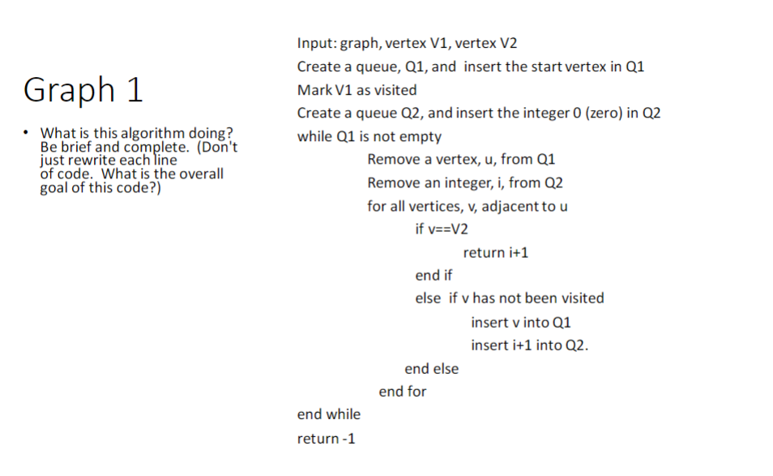
Notes:
In the last lecture we covered BFS and DFS and today we will continue with some applications of these traversals in common problem.

Slide 129
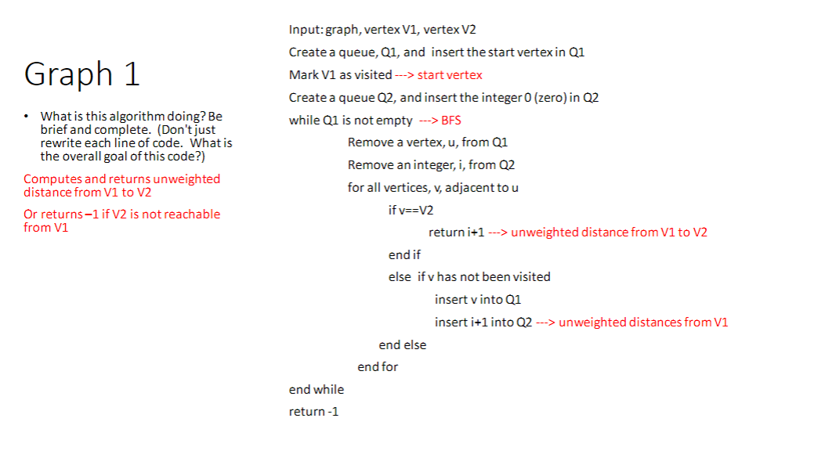
Notes:
In the last lecture we covered BFS and DFS and today we will continue with some applications of these traversals in common problem.

Slide 130
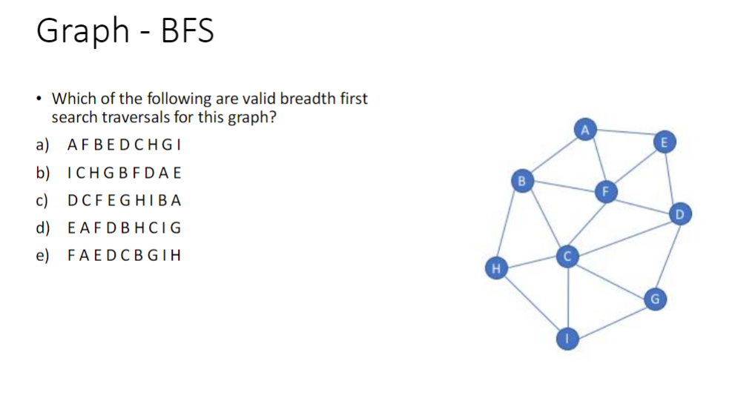
Notes:
In the last lecture we covered BFS and DFS and today we will continue with some applications of these traversals in common problem.

Slide 131
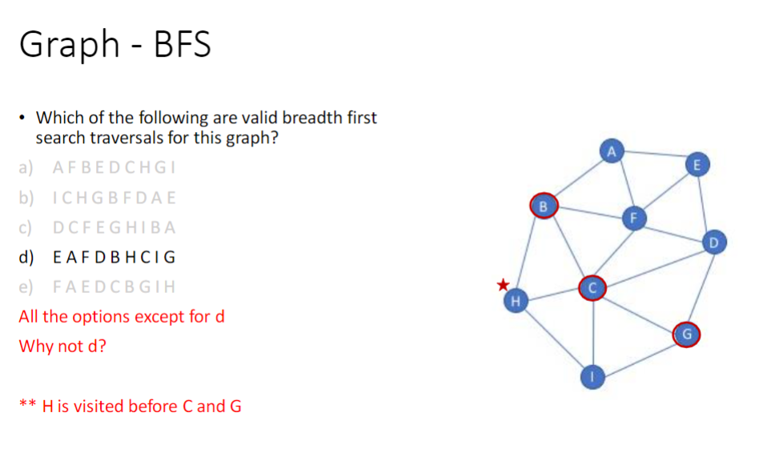
Notes:
In the last lecture we covered BFS and DFS and today we will continue with some applications of these traversals in common problem.

Slide 132
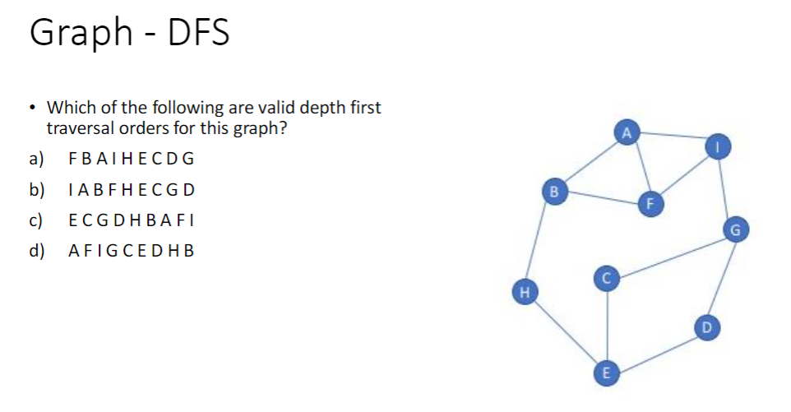
Notes:
In the last lecture we covered BFS and DFS and today we will continue with some applications of these traversals in common problem.

Slide 133
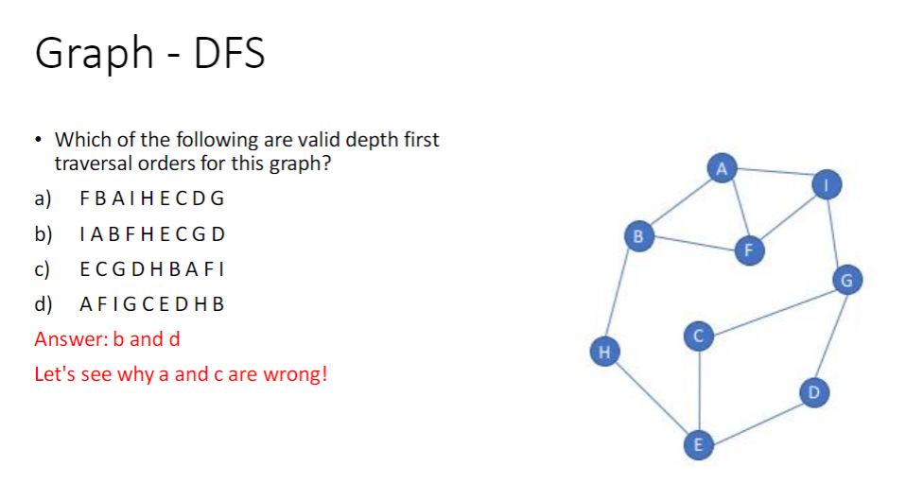
Notes:
In the last lecture we covered BFS and DFS and today we will continue with some applications of these traversals in common problem.

